Slide 1
Project SciKey

Slide 2
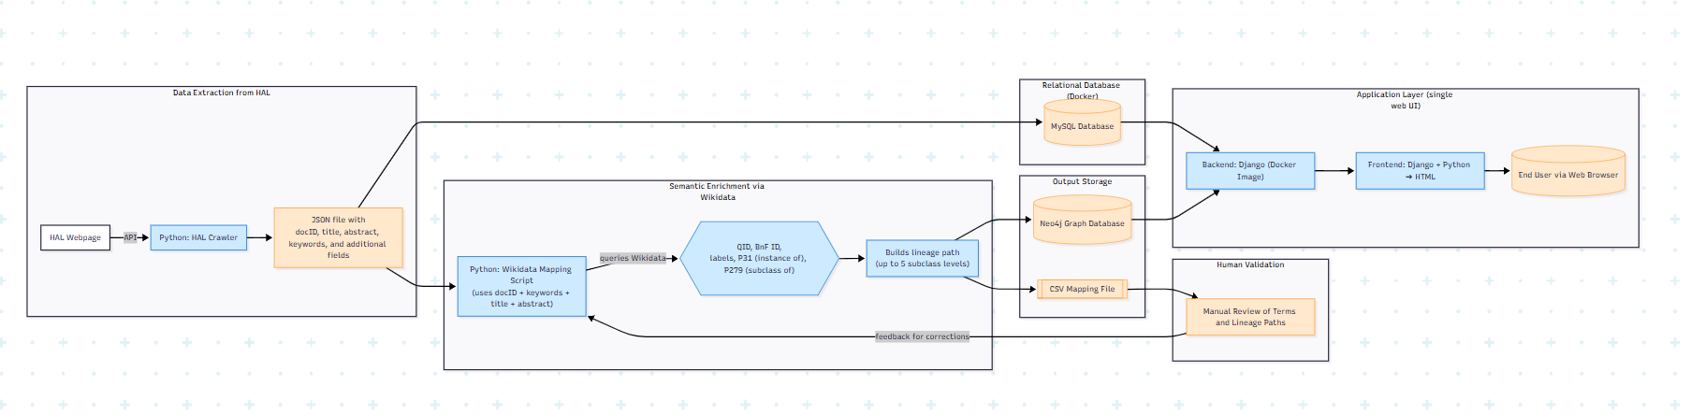
End-to-End Data Integration and Semantic Mapping Architecture

Slide 3
End-to-End Data Integration and Semantic Mapping Architecture

Slide 4
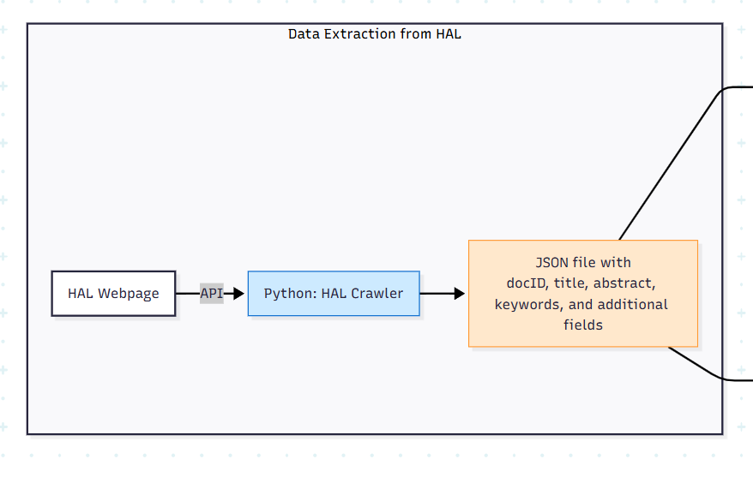
Data Extraction from HAL

Slide 5
End-to-End Data Integration and Semantic Mapping Architecture

Slide 6
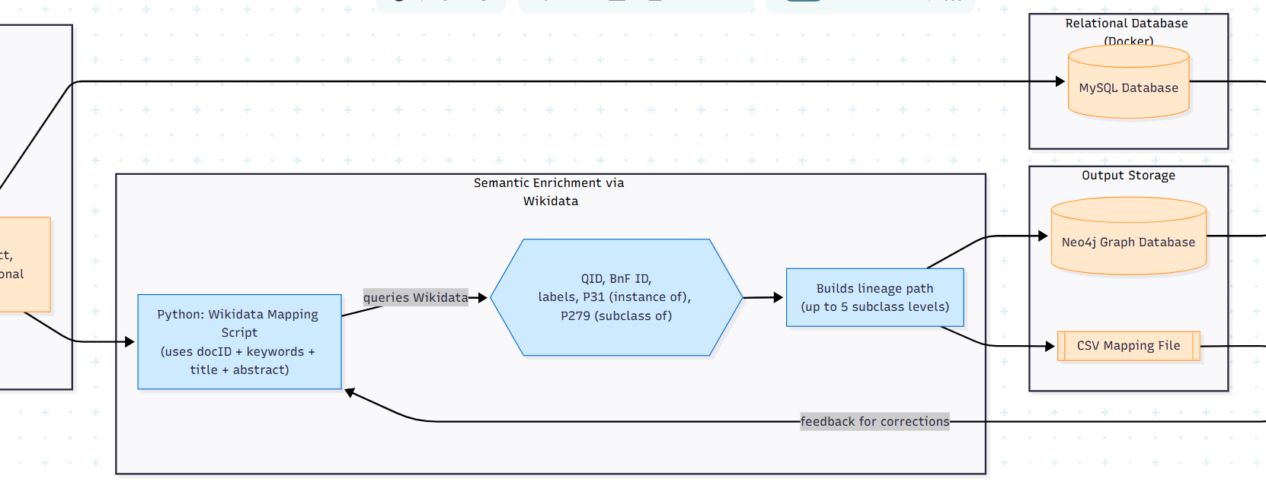
Wikidata

Slide 7
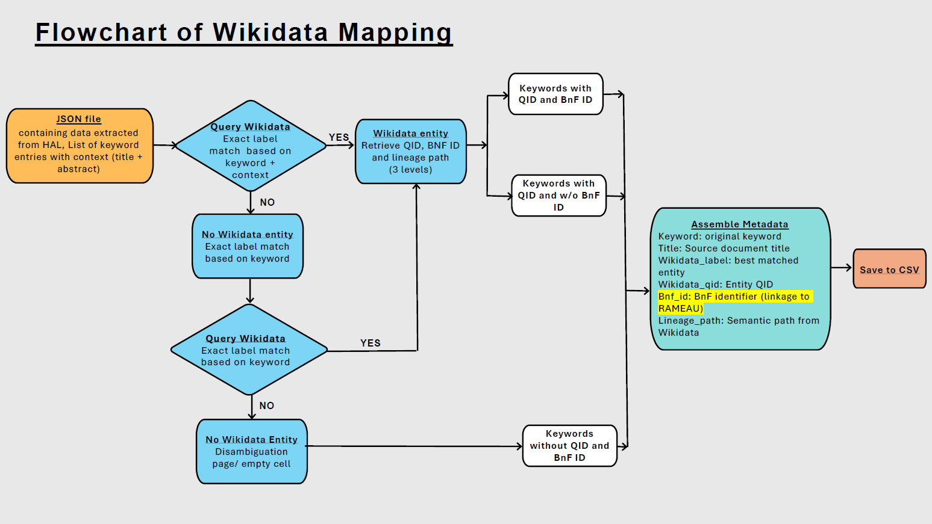
Final documentation

Slide 8
End-to-End Data Integration and Semantic Mapping Architecture

Slide 9
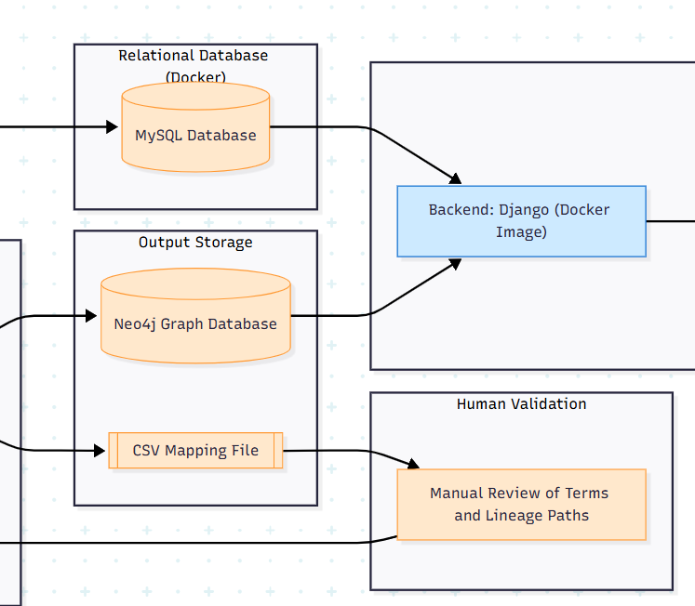
Human Validation and Neo4j + MySQL

Slide 10
End-to-End Data Integration and Semantic Mapping Architecture

Slide 11
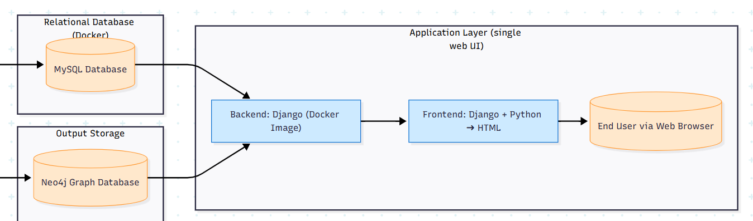
Application Layer

